Slide 1
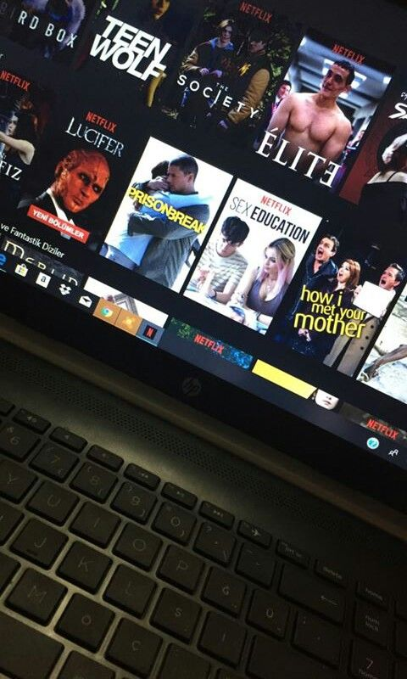

DONATION WEBSITE
BLESSING
Developers
Aman Kumar Sharma
Aman Chaudhary

Slide 2
Index
1
Introduction
2
Objectives
3
Existing System
4
Advantages of Proposed System
5
Need of the System
6
Modules
7
Conclusion

Slide 3
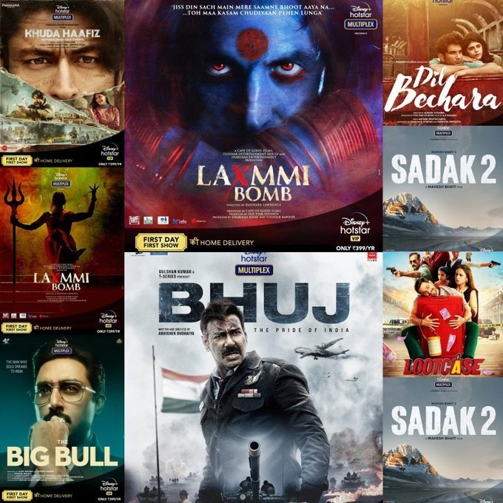
Introduction
Donation Website this serves as a bridge between those with generous hearts and impactful cause in need.
Our mission is clear to empower positive change through act of giving. Every contribution, regardless of size, plays a vital role in creating a ripple effect of goodness
The focus of this Project is to reduce the amount of wastage of needy items and being used to the needy people.

Slide 4
Reduce Lack of awareness.
Enable easy interaction between donor and volunteer.
It is very much faster than manual system .
Promote community engagement through events and activities.
Objectives
of Blessings

Slide 5
Existing System
Presently People who wish to donate money they donate through website.
The people wishing to donate will be able to see all the options available with them to do the same. They wish to donate then shall be collected by a volunteer that selected by admin.
The donated money safely reach the intended needy persons after this interaction.

Slide 6
Advantages of Proposed System
User-Friendly Interface: A user-friendly interface ensures that donors can easily navigate the website, find the information, and make donations without encountering obstacles.
Secure Donation Process: Implementing secure payment gateways assures donors that their financial information is protected, building trust and encouraging more contributions.
Transparency and Accountability: Providing transparency about how donations are used and showcasing the impact of contributions builds trust among donors and enhance the credibility of the organization
Mobile Optimization: Optimizing the website for mobile devices ensures that donors can contribute conveniently from smartphones and tablets, expanding the reach of your fundraising efforts.

Slide 7
Need of The System
There is always a need of a system that will provide an interactive platform between donors and NGOs(Volunteers). This system will reduce the manual operation required to collect donations. And also generates the various reports for analysis.
Thus, there is a big need of an online donation management system, which provides all the above mentioned facilities and many more .

Slide 8
Project Scope
The project has a wide scope, as it is not intended to a particular organization. This project is going to develop generic software, which can be applied by any businesses organization. More over it provides facility to its users. Also the software is going to provide a huge amount of summary data.

Slide 9
Modules:
In this project, we use HTML, CSS, JAVASCRIPT and Payment Gateways.
It has three modules :
Donor
Volunteer
Admin

Slide 10
Donor Modules:
Add Donation Detail
View Donation History
Edit Profile
Change Password

Slide 11
Volunteer Modules:
• View Donation Collection Request
• Update Donation Status and Remark
• View Donation History
• Edit Profile
• Change Password

Slide 12
Admin Modules:
• Admin is the super user of the website who can manage everything on the website. Admin can log in through the login page
• Dashboard: In this section, admin can see all detail in brief like the total new donation request, Total accepted donation, Total donation delivered, Total donors, Total volunteers and Total donation area.
• View All New Donation Request.
• Accept or Reject Donation.
• Assign Volunteer and Donation Area.

Slide 13
Conclusion
It has been a great pleasure for me to work on this exciting and challenging project. This project proved good for me as it provided practical knowledge of Frontend. It also provides knowledge about the latest technology used in developing website that will be great demand in future.
The impact of a well-designed donation website extends fundraising; The transparency and accountability inherent in these platforms also build trust among donors, ensuring that their contributions are directed toward the intended beneficiaries with efficiency and effectiveness.

Slide 14


